Slide 1
Outline
Introduction
Background
Distributed Database Design
Database Integration
Semantic Data Control
Distributed Query Processing
Distributed Transaction Management
Data Replication
Parallel Database Systems
Distributed Object DBMS
Peer-to-Peer Data Management
P2P infrastructure
Schema mapping
Querying over P2P systems
Replica management in P2P systems
Web Data Management
Current Issues

Slide 2
Motivations
P2P systems
Each peer can have same functionality
Decentralized control, large scale
Low-level, simple services
File sharing, computation sharing, com. sharing
Traditional distributed DBMSs
High-level data management services
queries, transactions, consistency, security, etc.
Centralized control, limited scale
P2P + distributed database
Why? How?

Slide 3
Why High-level P2P Data Sharing?
Professional community example
Medical doctors in a hospital may want to share (some of) their patient data for an epidemiological study
They have their own, independent patient descriptions
They want to ask queries such as “age and weight of male patients diagnosed with disease X …” over their own descriptions
They don’t want to create a database and set a centralized server

Slide 4
Problem Definition
P2P system
No centralized control, very large scale
Very dynamic: peers can join and leave the network at any time
Peers can be autonomous and unreliable
Techniques designed for distributed data management need be extended
Too static, need to be decentralized, dynamic and self-adaptive

Slide 5
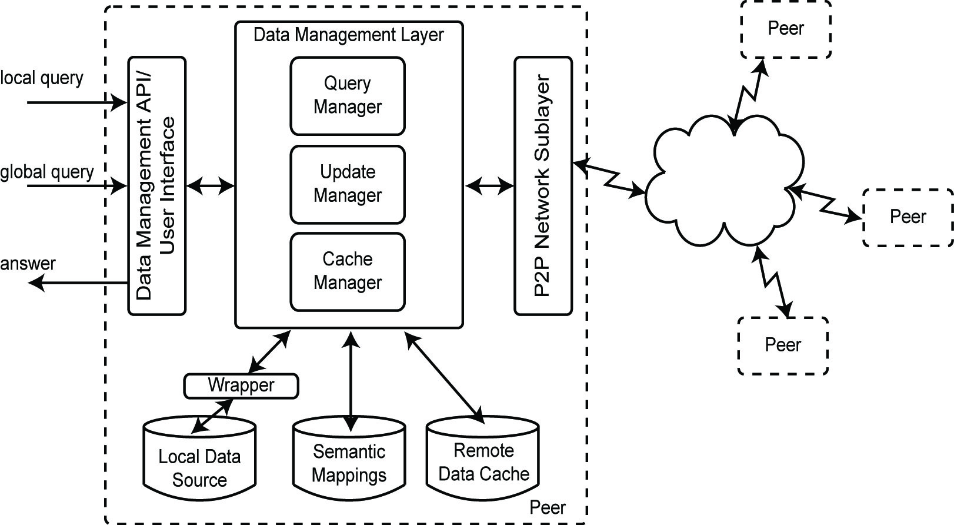
Peer Reference Architecture

Slide 6
Potential Benefits of P2P Systems
Scale up to very large numbers of peers
Dynamic self-organization
Load balancing
Parallel processing
High availability through massive replication

Slide 7
P2P vs Traditional Distributed DBMS
 | P2P | Distributed DBMS
Joining the network | Upon peer’s initiative | Controled by DBA
Queries | No schema, key-word based | Global schema, static optimization
Query answers | Partial | Complete
Content location | Using neighbors or DHT | Using directory

Slide 8
Requirements for P2P Data Management
Autonomy of peers
Peers should be able to join/leave at any time, control their data with respect to other (trusted) peers
Query expressiveness
Key-lookup, key-word search, SQL-like
Efficiency
Efficient use of bandwidth, computing power, storage

Slide 9
Requirements for P2P Data Management (cont’d)
Quality of service (QoS)
User-perceived efficiency: completeness of results, response time, data consistency, …
Fault-tolerance
Efficiency and QoS despite failures
Security
Data access control in the context of very open systems

Slide 10
P2P Network Topologies
Pure P2P systems
Unstructured systems
e.g. Napster, Gnutella, Freenet, Kazaa, BitTorrent
Structured systems (DHT)
e.g. LH* (the earliest form of DHT), CAN, CHORD, Tapestry, Freepastry, Pgrid, Baton
Super-peer (hybrid) systems
e.g. Edutela, JXTA
Two issues
Indexing data
Searching data

Slide 11
P2P Unstructured Network
p2p
data
p2p
data
p2p
data
peer 4
p2p
data
peer 1
peer 2
peer 3
High autonomy (peer only needs to know neighbor to login)
Searching by
flooding the network: general, may be inefficient
Gossiping between selected peers: robust, efficient
High-fault tolerance with replication

Slide 12
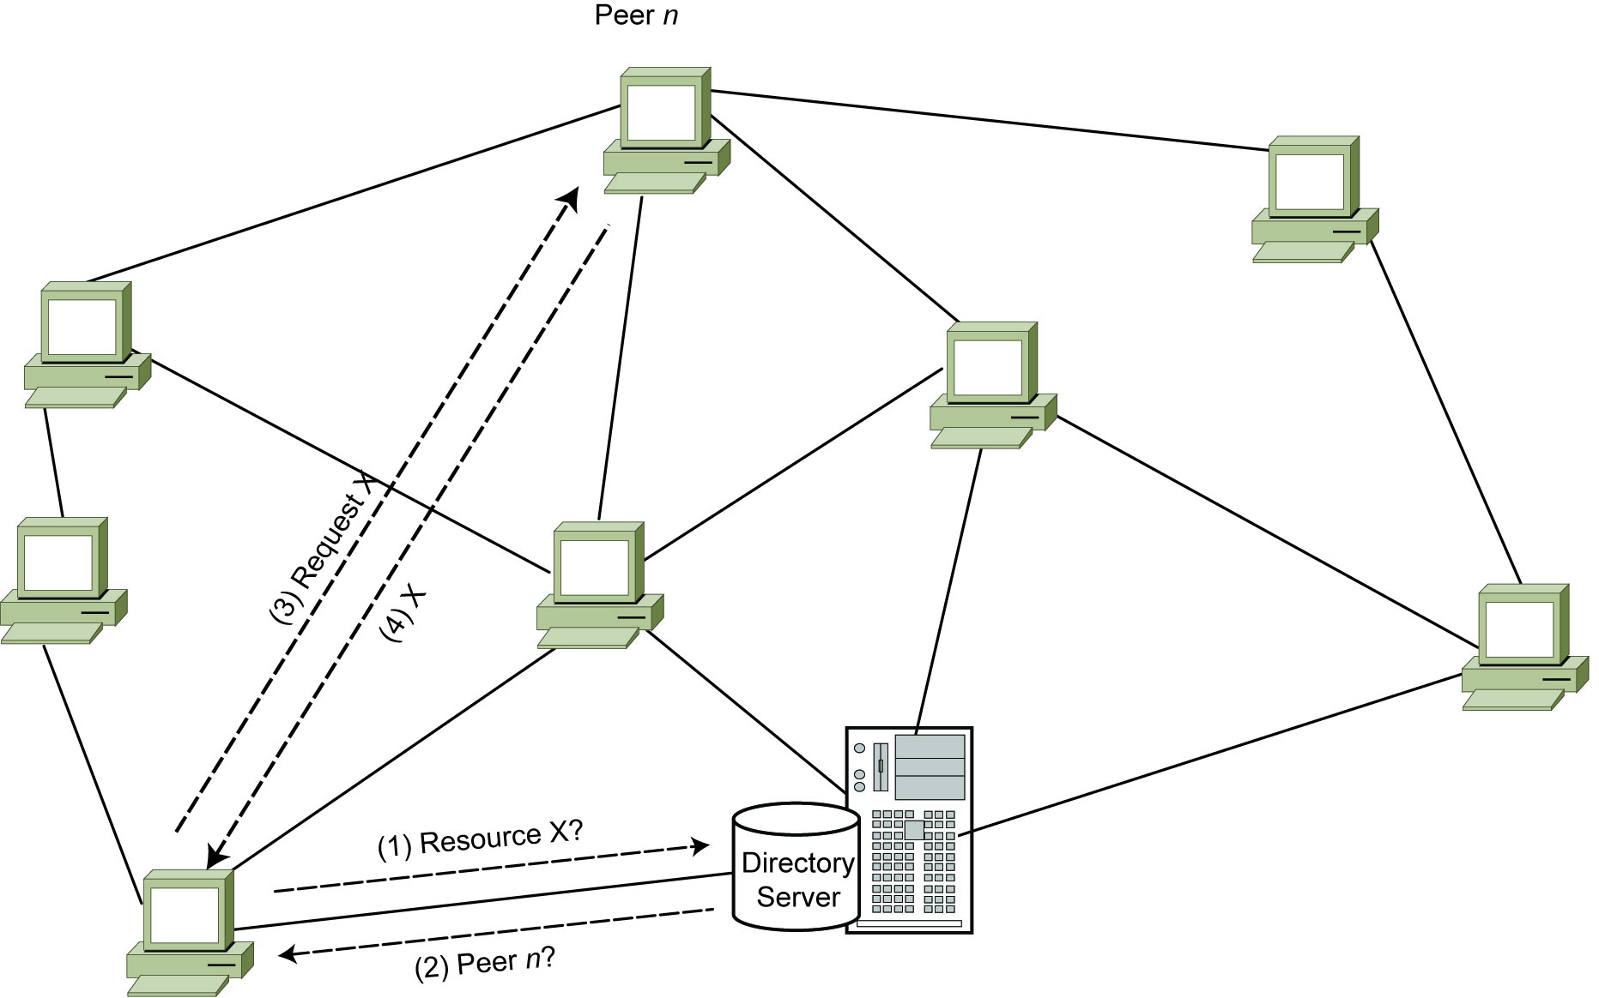
Search over Centralized Index
A peer asks the central index manager for resource
The response identifies the peer with the resource
The peer is asked for the resource
It is transferred

Slide 13
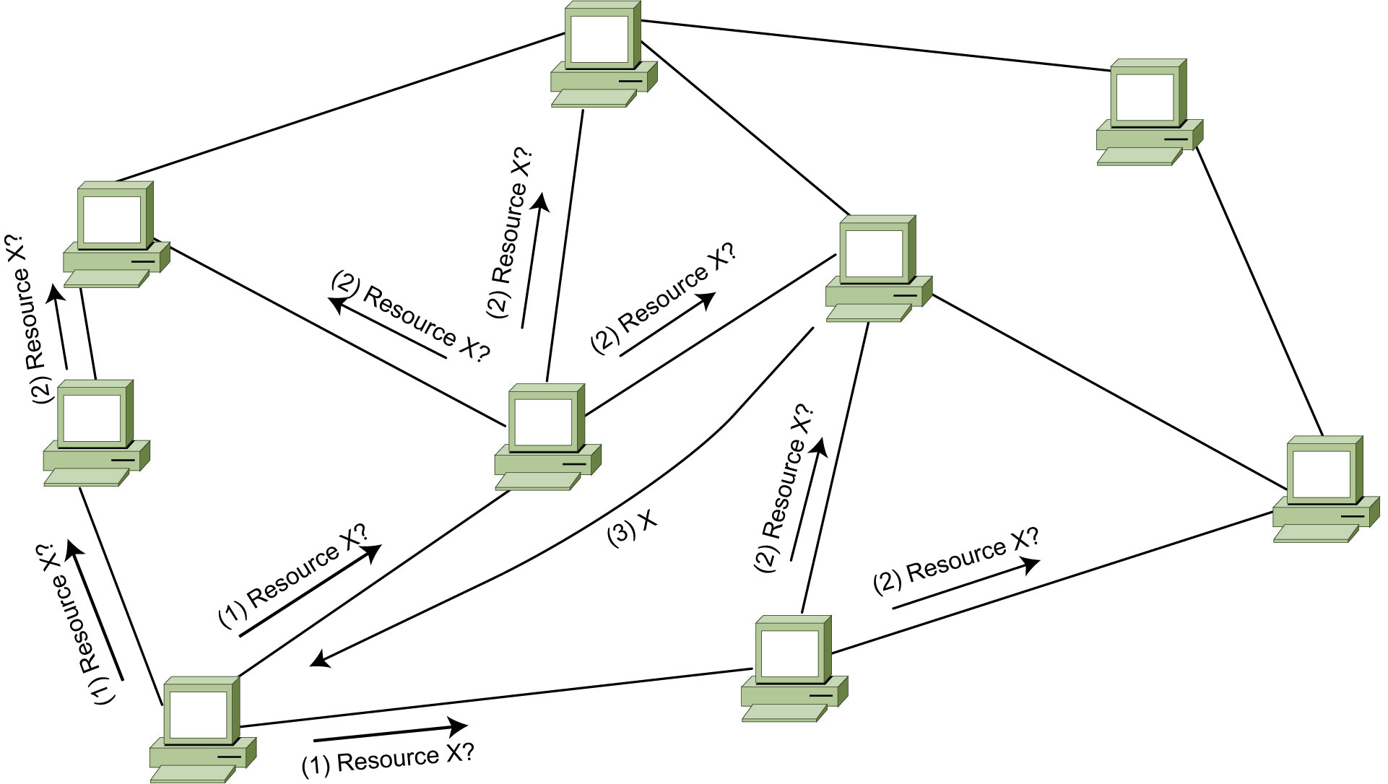
Search over Distributed Index
A peer sends the request for resource to all its neighbors
Each neighbor propagates to its neighbors if it doesn’t have the resource
The peer who has the resource responds by sending the resource

Slide 14
P2P Structured Network
Distributed Hash Table (DHT)
h(k₁)= p₁
h(k₂)= p₂
h(k₃)= p₃
h(k₄)= p₄
p2p
d(k₁)
p2p
d(k₂)
p2p
d(k₃)
p2p
d(k₄)
peer 1
peer 2
peer 3
peer 4
Simple API with put(key, data) and get(key)
The key (an object id) is hashed to generate a peer id, which stores the corresponding data
Efficient exact-match search
O(log n) for put(key, data), get(key)
Limited autonomy since a peer is responsible for a range of keys

Slide 15
Super-peer Network
sp2sp
sp2p
sp2sp
sp2p
p2sp
data
p2sp
data
p2sp
data
p2sp
data
peer 1
peer 2
peer 3
peer 4
Super-peers can perform complex functions (meta-data management, indexing, access control, etc.)
Efficiency and QoS
Restricted autonomy
SP = single point of failure ⇒ use several super-peers

Slide 16
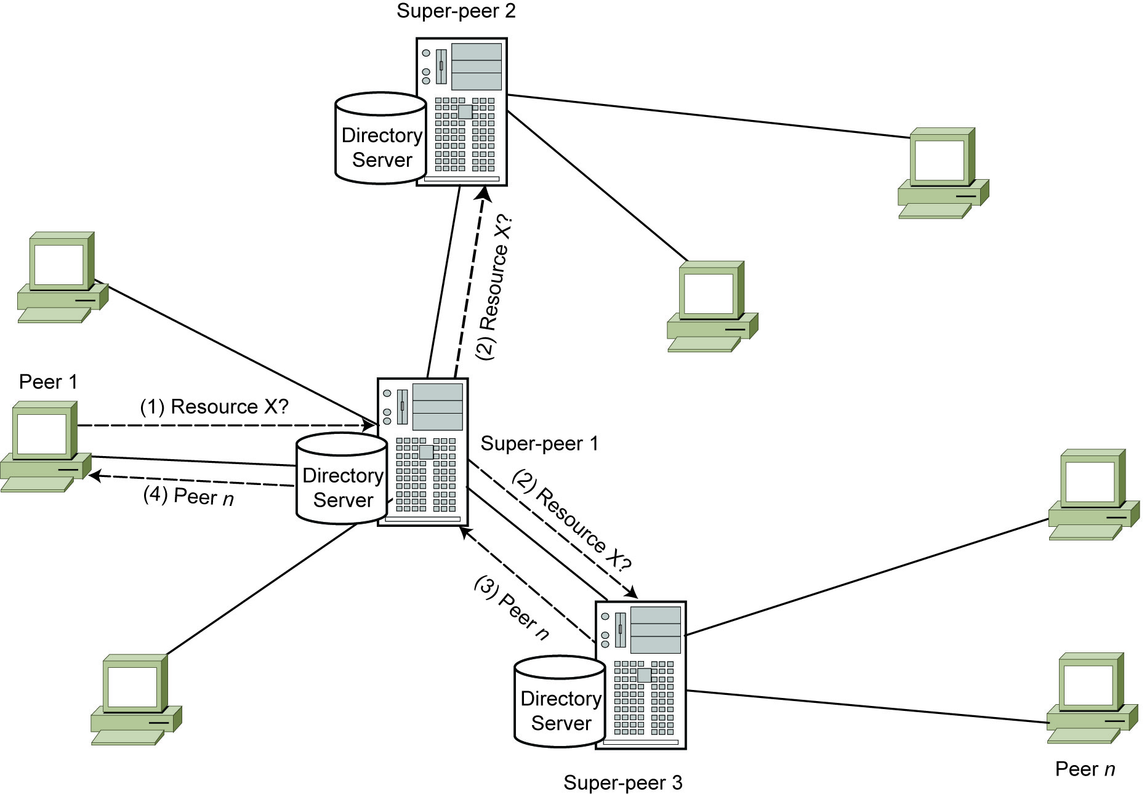
Search over a Super-peer System
A peer sends the request for resource to all its super-peer
The super-peer sends the request to other super-peers if necessary
The super-peer one of whose peers has the resource responds by indicating that peer
The super-peer notifies the original peer

Slide 17
P2P Systems Comparison
Requirements | Unstructured | DHT | Super-peer
Autonomy | high | low | avg
Query exp. | high | low | high
Efficiency | low | high | high
QoS | low | high | high
Fault-tolerance | high | high | low
Security | low | low | high

Slide 18
P2P Schema Mapping
Problem: support decentralized schema mapping so that a query expressed on one peer’s schema can be reformulated to a query on another peer’s schema
Main approaches
Pairwise schema mapping
Mapping based on machine learning
Common agreement mapping

Slide 19
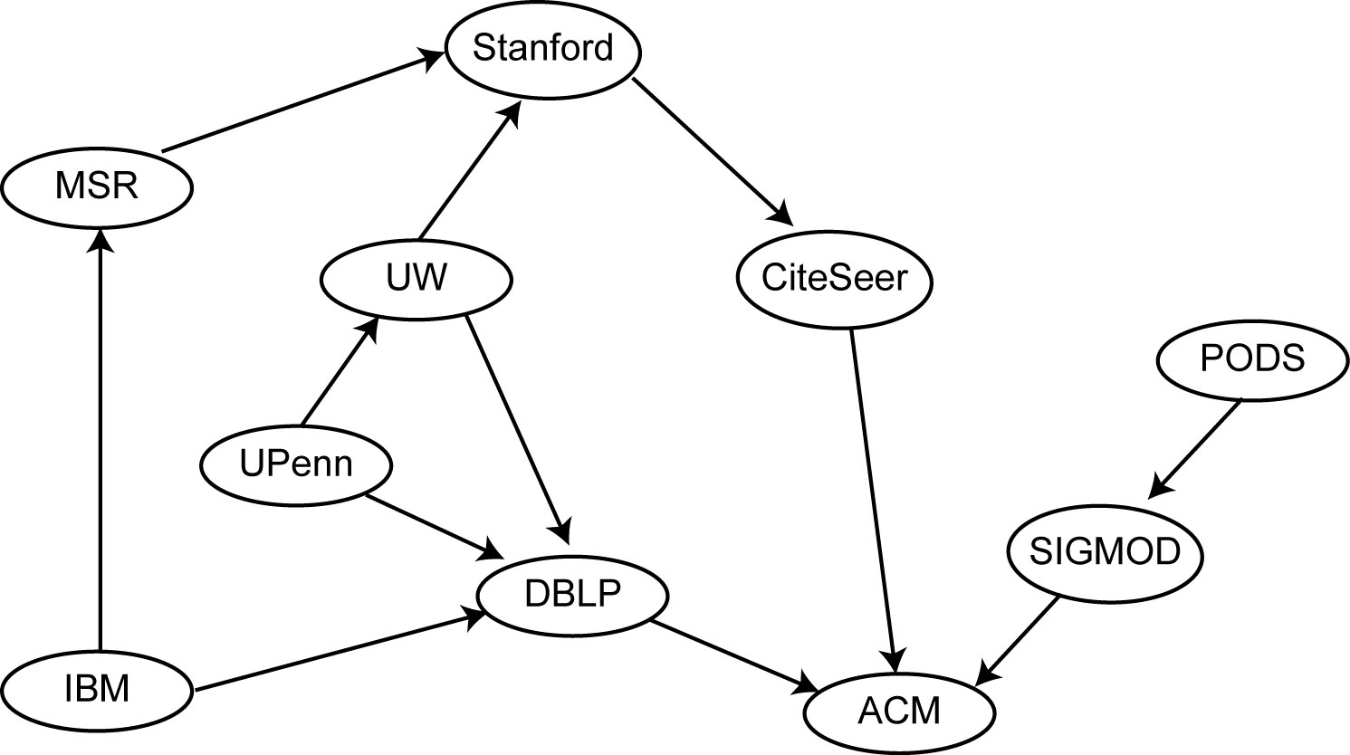
Pairwise Schema Mapping
Each user defines the mapping between the local schema and the schema of any other peer that contains data that are of interest
Relying on the transitivity of the defined mappings, the system tries to extract mappings between schemas that have no defined mapping

Slide 20
Mapping Based on Machine Learning
This approach is generally used when the shared data are defined based on ontologies and taxonomies as proposed for the semantic web
It uses machine learning techniques to automatically extract the mappings between the shared schemas
The extracted mappings are stored over the network, in order to be used for processing future queries

Slide 21
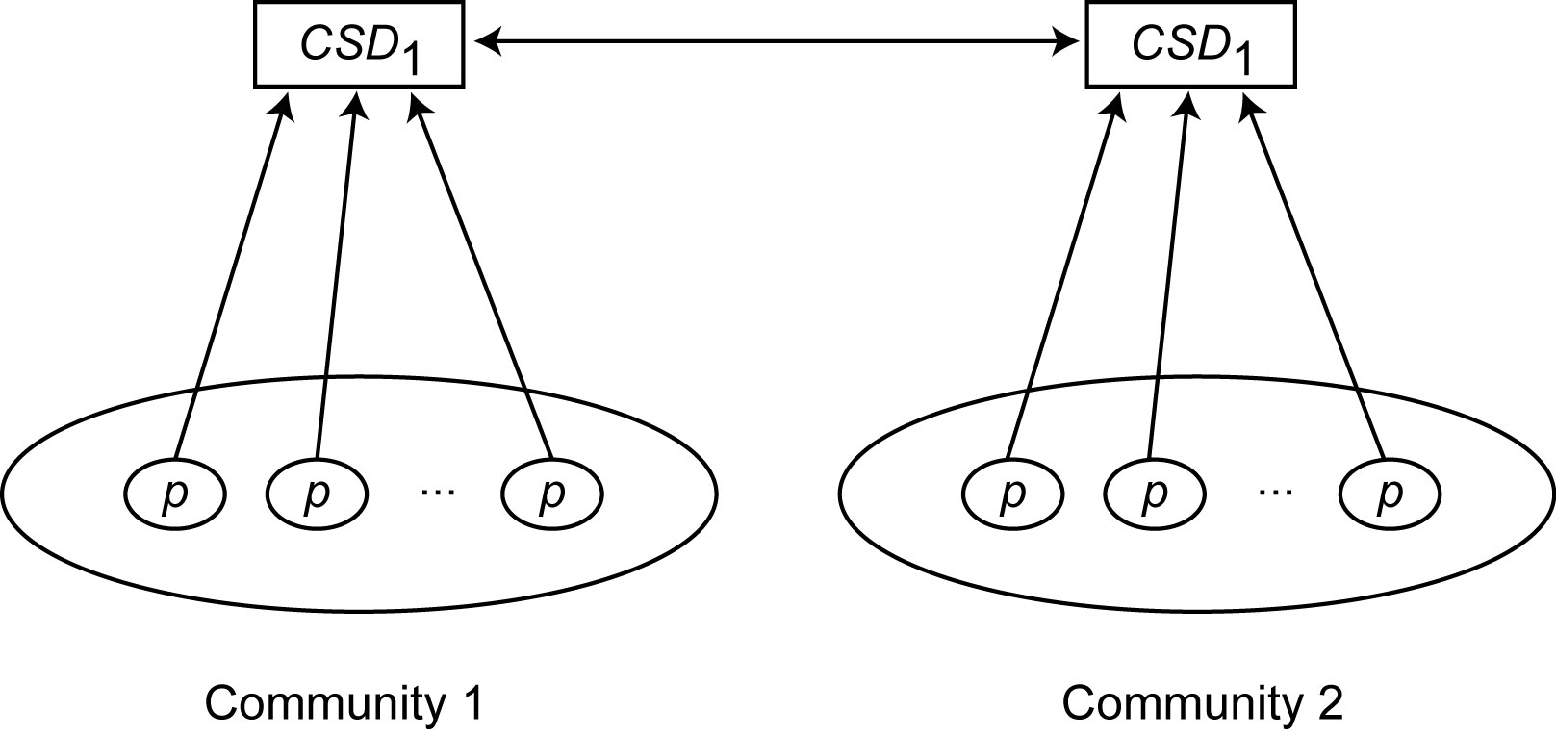
Common Agreement Mapping
Some (cooperating) peers must agree on a Common Schema Description (CSD)
Given a CSD, a peer schema can be specified using views
Similar to the LAV approach
When a peer decides to share data, it needs to map its local schema to the CSD

Slide 22
Querying over P2P Systems
P2P networks provide basic query routing
Sufficient for simple, exact-match queries, e.g. with a DHT
Supporting more complex queries, particularly in DHTs, is difficult
Main types of complex queries
Top-k queries
Join queries
Range queries

Slide 23
Top-k Query
Returns only k of the most relevant answers, ordered by relevance
Like for a search engine
Scoring function (sf) determines the relevance (score) of answers to the query
Example
SELECT *
FROM Patient P
WHERE (P.disease = “diabetes”) AND
(P.height < 170) AND (P.weight > 70)
ORDER BY sf(height, weight)
STOP AFTER 10
Example of sf: weight − (height -100)

Slide 24
General Model for Top-k Queries
Suppose we have:
n data items
items can be document, tuples, etc.
m lists of n data items such that
Each data item has
a local score in each list
an overall score computed based on its local scores in all lists using a given scoring function
Each list
contains all n data items (or item ids)
is sorted in decreasing order of the local scores
The objective is:
Given a scoring function, find the k data items whose overall scores are the highest

Slide 25
Execution Cost of Top-k Queries
Two modes of access to a sorted list
Sorted (sequential) access
Starts with the first data item, then accesses each next item
Random access
Looks up a given data item in the list by its identifier (e.g. TID)
Given a top-k algorithm A and a database D (i.e. set of sorted lists), the cost of executing A over D is:
Cost(A, D) = (#sorted-access * sorted-access-cost) + (#random-access * random-access-cost)

Slide 26
Basic Top-k Algorithms
Fagin’s Algorithm (FA)
General model of top-k queries using sorted lists
Simple algorithm
Do sorted access in parallel to the lists until at least k data items have been seen in all lists
Threshold Algorithm (TA)
Proposed independently by several groups
Efficient algorithm over sorted lists
The basis for many TA-style distributed algorithms
Mainly for DHTs
Algorithms for unstructured or super-peer simpler

Slide 27
TA
Similar to FA in doing sorted access to the lists
But different stopping condition
Unlike FA, no need to wait until the lists give k items
Once an item has been seen from a sorted access, get all its scores through random access
But how do we know that the scores of seen items are higher than those of unseen items?
Use a threshold (T) to predict maximum possible score of unseen items
based on the last scores seen in the lists under sorted access
Then stop when there are at least k data items whose overall score ≥ T

Slide 28
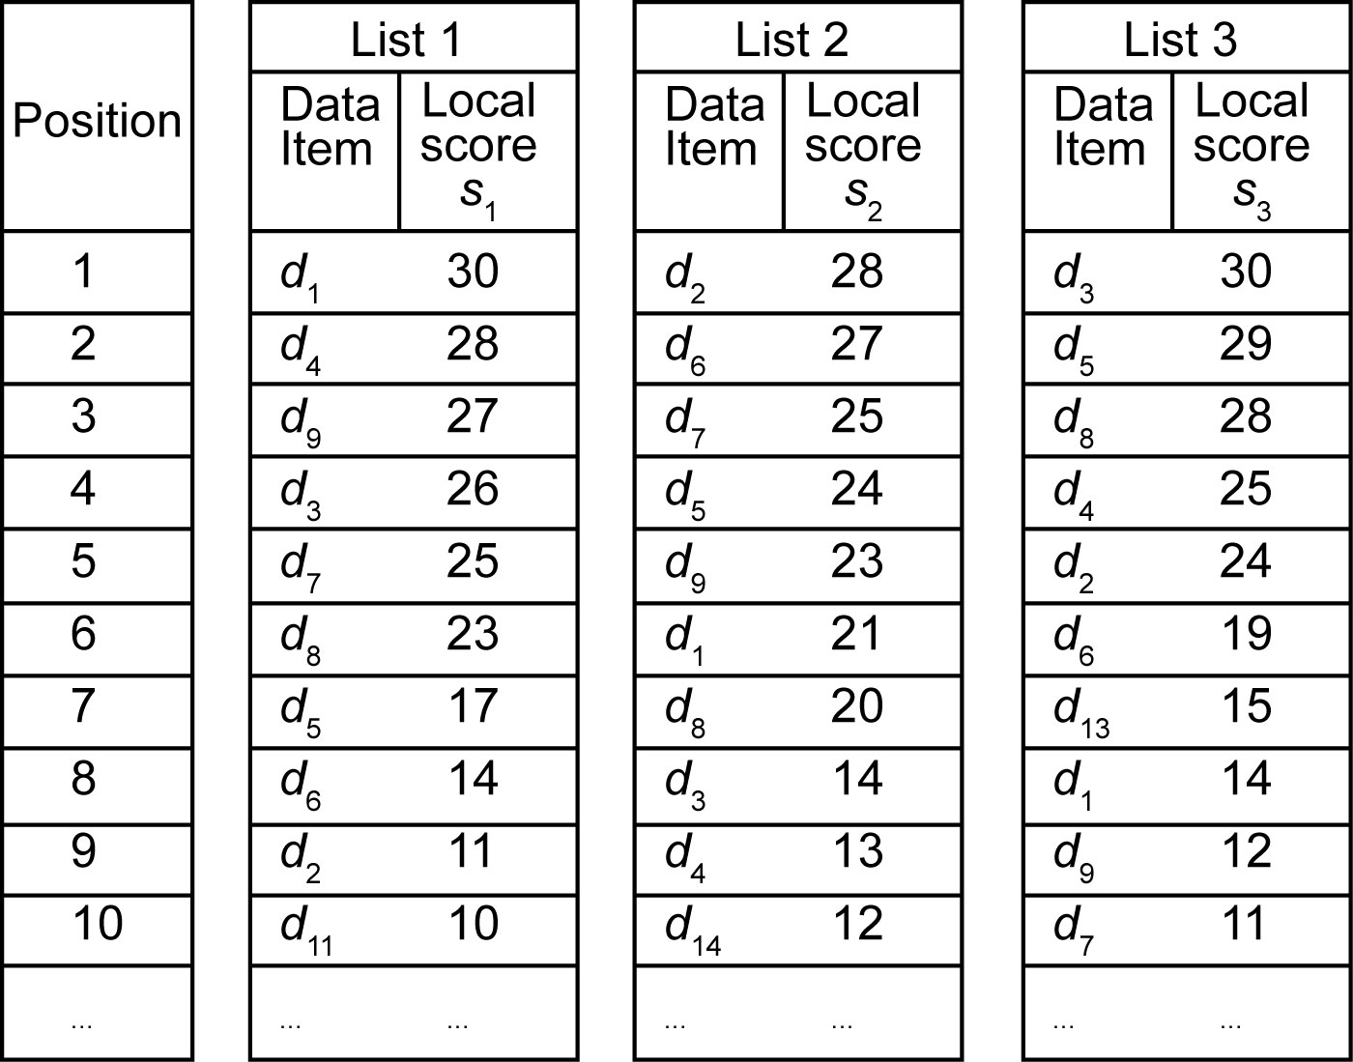
TA Example
Assume sf( ) = s₁ + s₂ + s₃, k = 3,
Y: {top seen items with overall scores}
At position 1
Look up the local scores of items d₁, d₂ and d₃ in other lists using random access and compute their overall scores (which are 65, 63 and 70, respectively)
Y = {(d₁,70) (d₂,65) (d₃,63)}, T = 30 + 28 + 30 = 88
Then
At position 2, Y = {(d₃,70) (d₄,70) (d₅,65)}, T = 84
At position 3, Y = {(d₃,71) (d₅,70) (d₈,70)}, T = 80
At position 4, Y = same, T = 75
At position 5, Y = same, T = 72
At position 6, Y = same, T = 63
which is less than the overall score of the three data items in Y. Thus, TA stops
Note that the contents of Y at position 6 is exactly the same as at position 3

Slide 29
Improvement over TA: BPA
Best Position Algorithm
Main idea: keep track of the positions (and scores) of the items seen under sorted or random access
Enables BPA to stop as soon as possible
In the previous example, BPA stops at position 3
Best position = the greatest seen position in a list such that any position before it is also seen
Thus, we are sure that all positions between 1 and best position have been seen
Stopping condition
Based on best positions overall score, i.e. the overall score computed based on the best positions in all lists
Notes:
BPA also does sorted access to the lists

Slide 30
Top-k Query Processing in DHTs
Given
A DHT network
T : a set of tuples which are stored in the DHT
Q : a top-k query
sf : a scoring function
Goal
Retrieve efficiently the k tuples stored in the DHT whose scores are the highest according to Q and sf
While avoiding centralized data storage
DHTop algorithm
TA style

Slide 31
Data Storage Mechanism
Two complementary methods for storing tuples in the DHT
Tuple storage: each tuple of a relation is stored in the DHT using its tuple’s identifier (e.g. primary key)
Allows to retrieve tuples using their identifier
Attribute storage: the values of some attributes of a tuple are stored individually in the DHT
Acts as secondary indices
Good support for exact match queries

Slide 32
Tuple Storage Method
Let
R (a₁, a₂, …, a_{m}) be a relation
t 〈v₁, v₂, …, v_{m}〉 be a tuple of R
v₁ be the primary key of tuple t
h : a hash function that hashes its inputs into a DHT key
To store tuple t in the DHT, a peer does as follows:
ts_key = h(R, v₁);
put(ts_key,⟨v₁, v₂, …, v_{m}⟩);

Slide 33
Attribute-value storage
Domain partitioning
Let D_{a} be the domain of an attribute a
We partition D_{a} into n nonempty sub-domains d₁, d₂, ..., d_{n}
Example:
Attribute “weight”, with domain [0..200] in kilograms, can be partitioned into n=40 sub-domains [0..5), [5..10), …, [190..195), [195..200]
Exploitation by peers
All peers know the sub-domains of each attribute
Thus, each peer can locally execute the following function:
sd(a, v) : returns the sub-domain of attribute a to which value v belongs

Slide 34
Attribute-Value Storage (cont’d)
Let
R(a₁, a₂, …, a_{m}) be a relation
t ⟨v₁, v₂, …, v_{m}⟩ be a tuple of R
ts_key_{t} : the key used for storing tuple t in the DHT, i.e. h(R, v₁);
For storing the value v₂ of attribute a₂ in the DHT :
let d_{i} be the sub-domain to which v₂ belongs, i.e. d_{i} = sd(a₂, v₂);
avs_key ← h(R, a₂, d_{i});
put(avs_key, ⟨v₂ , ts_key_{t}⟩);
Two important features:
After retrieving an attribute value, we are able to retrieve its entire tuple
The values that are “relatively close” are stored at the same peer

Slide 35
DHTop
Two phases, executed by the peer where Q is originated
Phase 1: Prepare ordered lists of attributes’ sub-domains
For each scoring attribute a :
Step 1: create a list of a’s sub-domains, denoted by L_{a}
Step 2: remove useless sub-domains by considering Q’s conditions
E.g. condition a = c , remove all sub-domains except sub-domain of c
Step 3: sort L_{a} according to the positive impact of its sub-domains on the scoring function

Slide 36
DHTop (cont’d)
Phase 2: Continuously retrieve attribute values and their tuples until finding the k top tuples
For each scoring attribute a do in parallel
i=1
Repeat
Ask the peer p that maintains attribute values for L_{a}[i] (i.e. i-th sub-domain in the list) to return its attribute values in order of their positive impact on the scoring function
After receiving each attribute value v
Retrieve the entire tuple
Check End-Condition: are there at least k tuples (among the retrieved tuples) whose scores are greater than the threshold?
If end-condition holds, then exit
If all values maintained by p are received then
i = i + 1
Until (end-condition holds) or (i ≥ number of a’s sub-domains)

Slide 37
DHTop Threshold
Let a₁, a₂, ..., a_{m} be the scoring attributes, and v₁, v₂, ..., v_{m} be the last values retrieved for them
Let f be the scoring function
The threshold is δ = f(v₁, v₂, …, v_{m})

Slide 38
Top-k Query Processing in Unstructured Systems
Fully Decentralized (FD) algorithm
Fully decentralized query execution
No centralized information
Considers dynamicity of peers
Simple, efficient and fault-tolerant
Many optimizations possible

Slide 39
FD Algorithm Overview
Query Forward
If TTL > 0, send Q to your neighbors
Local query execution
Extract the k local top scores
Wait
Wait to receive from the neighbors their k top scores
The wait time is based on the received TTL, network parameters and peer’s local processing parameters
Merge-and-Backward
Extract k top scores from the local and received scores
Send the k top scores to your parent
Data retrieval (at the query originator)
Retrieve the overall top-k data using the final top scores

Slide 40
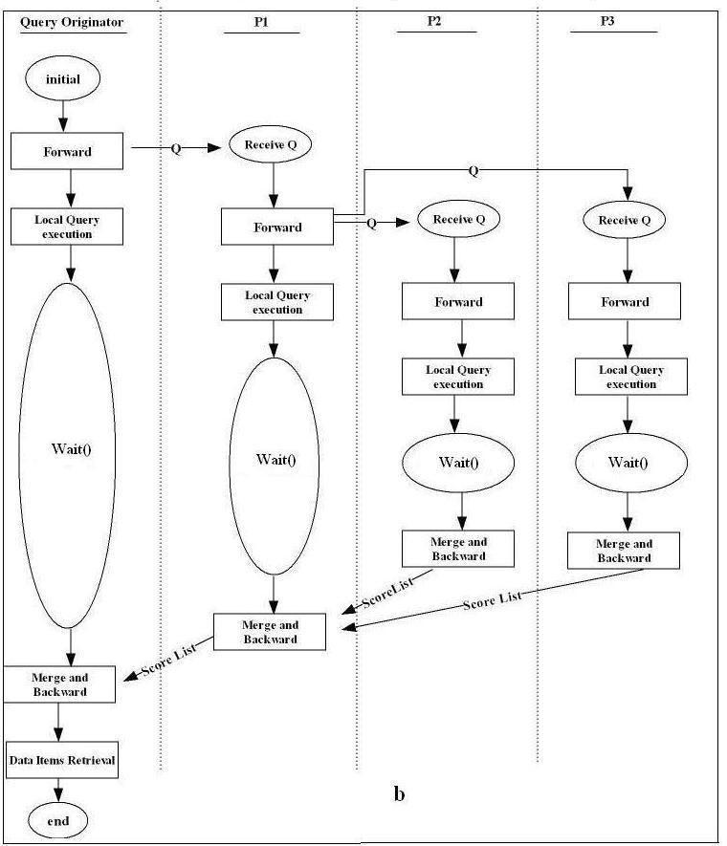
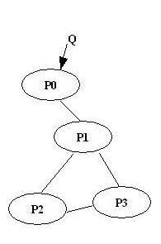
State Transition Diagram

Slide 41
FD Optimizations
What if a peer receives a score-list after its wait time has expired?
Urgent Score-list: a mechanism to backward a score-list to another peer still in the wait phase
What if the parent of a peer p leave the system?
If p has a neighbor that is not p’s child, the score-list can be sent to it as an urgent score-list
If p has not such a neighbor, it can send its merged score-list directly to the query originator
Return results ASAP
Without waiting for the entire result set

Slide 42
Join Query Processing in DHTs
A DHT relies on hashing to store and locate data
Basis for parallel hash join algorithms
Basic solution in the context of the PIER P2P system
Let us call it PIERjoin
Assume that the joined relations and the result relations have a home which are the peers that store horizontal fragments of the relation
Recall def. of home from Chapter 8
Make use of the put method for distributing tuples onto a set of peers based on their join attribute so that tuples with the same join attribute values are stored at the same peers
Then apply the probe/join phase

Slide 43
PIERjoin Algorithm
Multicast phase
The query originator peer multicasts Q to all peers that store tuples of the join relations R and S, i.e., their homes.
Hash phase
Each peer that receives Q scans its local relation, searching for the tuples that satisfy the select predicate (if any)
Then, it sends the selected tuples to the home of the result relation, using put operations
The DHT key used in the put operation uses the home of the result relation and the join attribute
Probe/join phase
Each peer in the home of the result relation, upon receiving a new tuple, inserts it in the corresponding hash table, probes the opposite hash table to find matching tuples and constructs the result joined tuples

Slide 44
Range Query Processing
Range query
WHERE clause of the form “attribute A in range [a; b]”
Difficult to support in structured P2P systems, in particular, DHTs
Hashing tends to destroy the ordering of data that is useful in finding ranges quickly
Two main approaches for supporting range queries in structured P2P systems
Extend a DHT with proximity or order-preserving properties
Problem: data skew that can result in peers with unbalanced ranges, which hurts load balancing
Maintain the key ordering with a tree-based structure
Better at maintaining balanced ranges of keys

Slide 45
BATON
BATON (BAlanced Tree Overlay Network)
Organizes peers as a balanced binary tree
Each node of the tree is maintained by a peer
The position of a node is determined by a (level, number) tuple, with level starting from 0 at the root, number starting from 1 at the root and sequentially assigned using in-order traversal
Each tree node stores links to its parent, children, adjacent nodes and selected neighbor nodes that are nodes at the same level
Two routing tables: a left routing table and a right routing table store links to the selected neighbor nodes

Slide 46
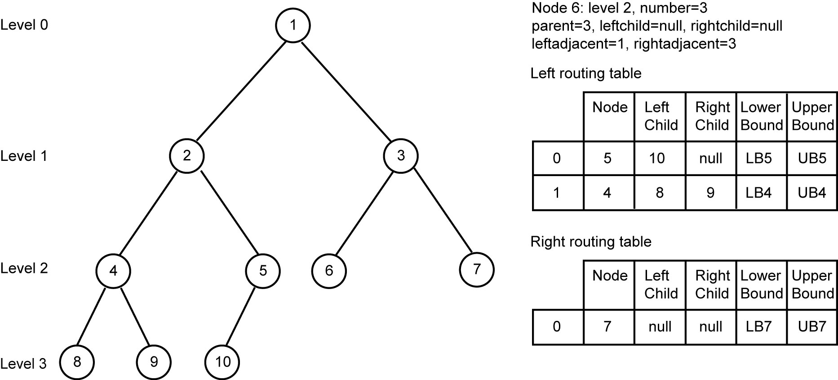
BATON Structure-tree Index
Each node (or peer) is assigned a range of values
Maintained at the routing table of each link
Required to be to the right of the range managed by its left subtree and less than the range managed by its right subtree

Slide 47
Range Query Processing in BATON
Input: Q, a range query in the form [a,b]
Output: T: result relation
1. Search for the peer storing the lower bound of the range
At query originator node do
find peer p that holds value a
send Q to p
2. A peer p that receives Q (from query originator or its left adjacent
peer) searches for local tuples and sends Q to its right adjacent node
At each peer p that receives Q
Tp = Range(p) ∩ [a,b]
send Tp to query originator
If (Range(RighAdjacent(p)) ∩ [a,b]) not empty
send Q to right adjacent peer of p
With X nodes covering the range, Q is answered in O(log n + X) steps

Slide 48
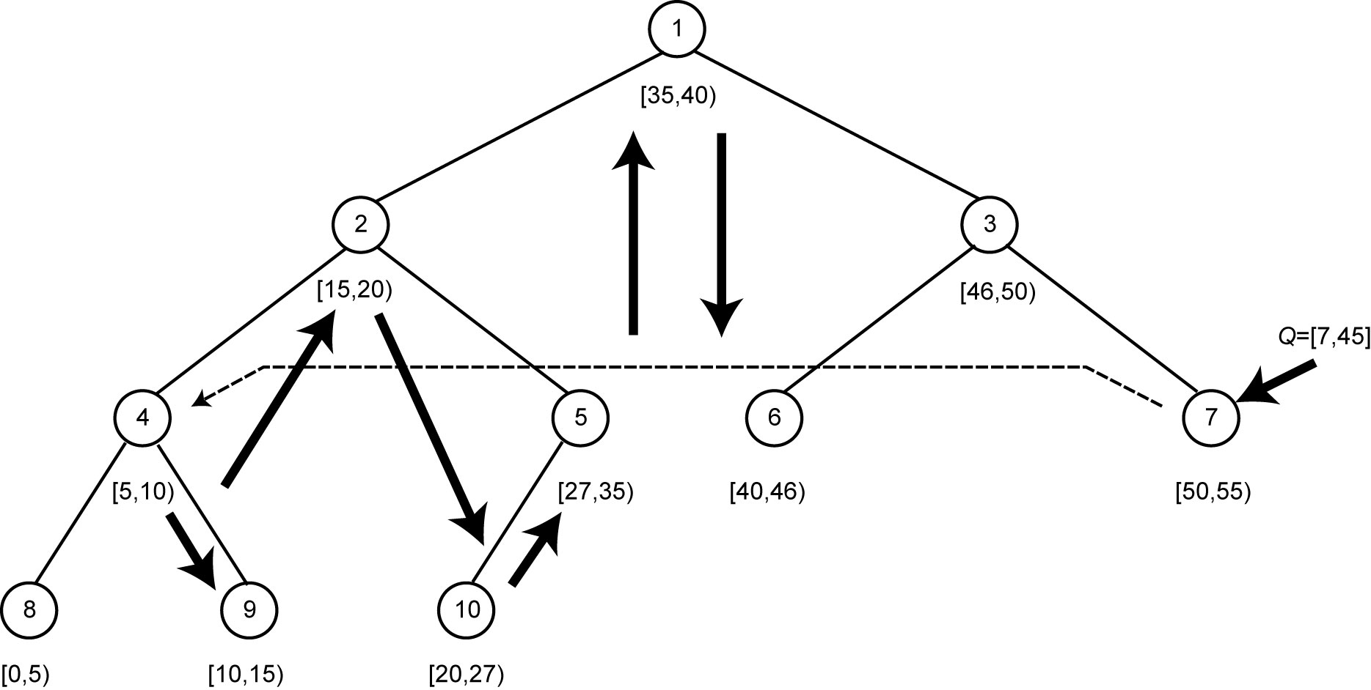
Example of Range Query Execution
Consider Q with range [7; 45] issued at node 7
First, execute an exact match query looking for a node containing the lower bound of the range (see dashed line)
Since the lower bound is in node 4’s range, check locally for tuples belonging to the range and forward Q to its adjacent right node (node 9)
Node 9 checks for local tuples belonging to the range and forwards Q to node 2
Nodes 10, 5, 1 and 6 receive Q, check for local tuples and contact their respective right adjacent node until the node containing the upper bound of the range is reached

Slide 49
Replica Consistency
To increase data availability and access performance, P2P systems replicate data, however, with very different levels of replica consistency
The earlier, simple P2P systems such as Gnutella and Kazaa deal only with static data (e.g., music files) and replication is “passive” as it occurs naturally as peers request and copy files from one another (basically, caching data)
In more advanced P2P systems where replicas can be updated, there is a need for proper replica management techniques
Replica consistency in DHTs
Basic support - Tapestry
Replica reconciliation - OceanStore

Slide 50
Tapestry
Decentralized object location and routing on top of a structured overlay
Routes messages to logical end-points (i.e., not associated with physical location), such as nodes or object replicas.
This enables message delivery to mobile or replicated endpoints in the presence of network instability
Location and routing
Let O be an object identified by id(O), the insertion of O involves two nodes: the server node (noted n_{s}) that holds O and the root node (noted n_{r}) that holds a mapping in the form (id(O); n_{s}) indicating that the object identified by id(O) is stored at node n_{s}
The root node is dynamically determined by a globally consistent deterministic algorithm

Slide 51
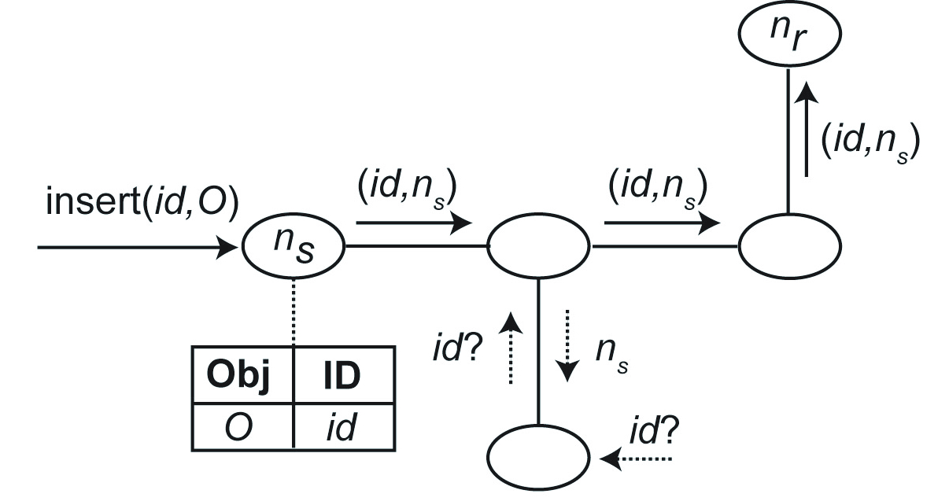
Object Publishing in Tapestry
When O is inserted into n_{s}, n_{s} publishes id(O) at its root node by routing a message from n_{s} to n_{r} containing the mapping (id(O); n_{s})
This mapping is stored at all nodes along the message path
During a location query (e.g., “id(O)?”, the message that looks for id(O) is initially routed towards n_{r}, but it may be stopped before reaching it once a node containing the mapping (id(O); n_{s}) is found
For routing a message to id(O)’s root, each node forwards this message to its neighbor whose logical identifier is the most similar to id(O)

Slide 52
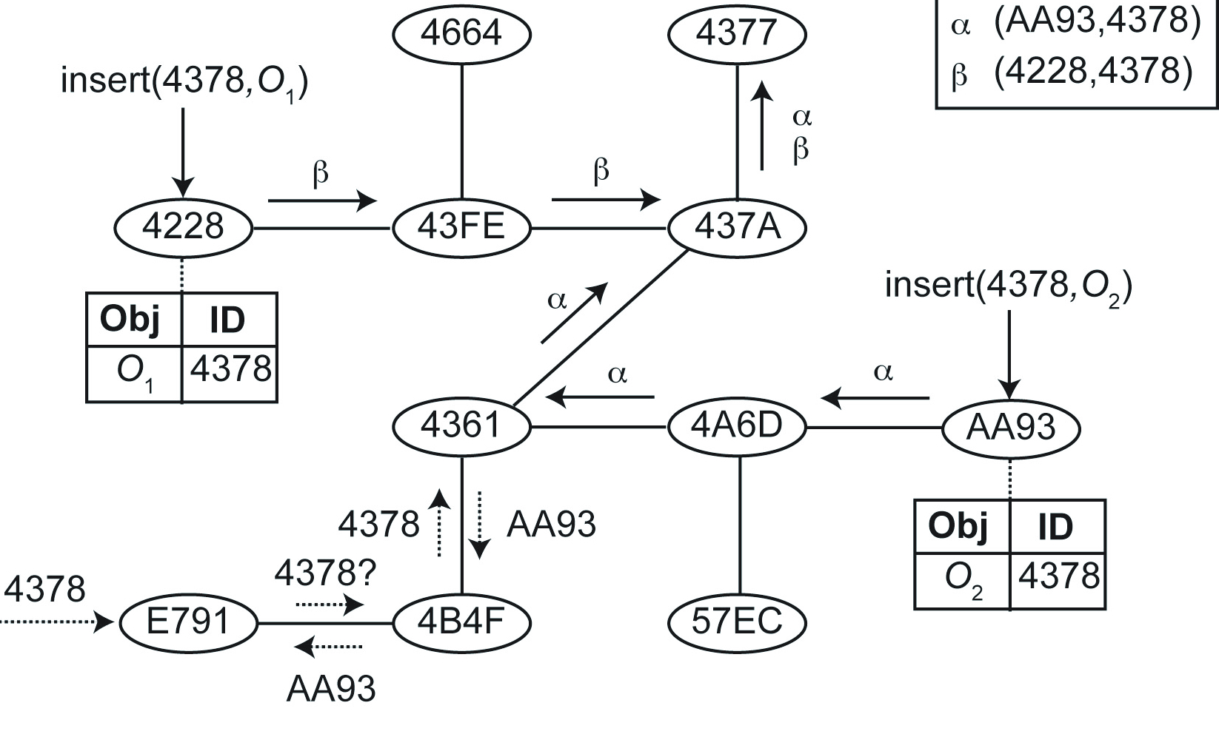
Replica Management in Tapestry
Each node represents a peer and contains the peer’s logical identifier in hexadecimal format
Two replicas O₁ and O₂ of object O (e.g., a book file) are inserted into distinct peers (O₁ at peer 4228 and O₂ at peer AA93). The identifier of O₁ is equal to that of O₂ (i.e., 4378)
When O₁ is inserted into its server node (peer 4228), the mapping (4378; 4228) is routed from peer 4228 to peer 4377 (the root node for O₁’s identifier)
As the message approaches the root node, the object and the node identifiers become increasingly similar
In addition, the mapping (4378; 4228) is stored at all peers along the message path

Slide 53
OceanStore
OceanStore is a data management system designed to provide continuous access to persistent information
Relies on Tapestry and assumes untrusted powerful servers connected by high-speed links
To improve performance, data are allowed to be cached anywhere, anytime
Allows concurrent updates on replicated objects; it relies on reconciliation to assure data consistency

Slide 54
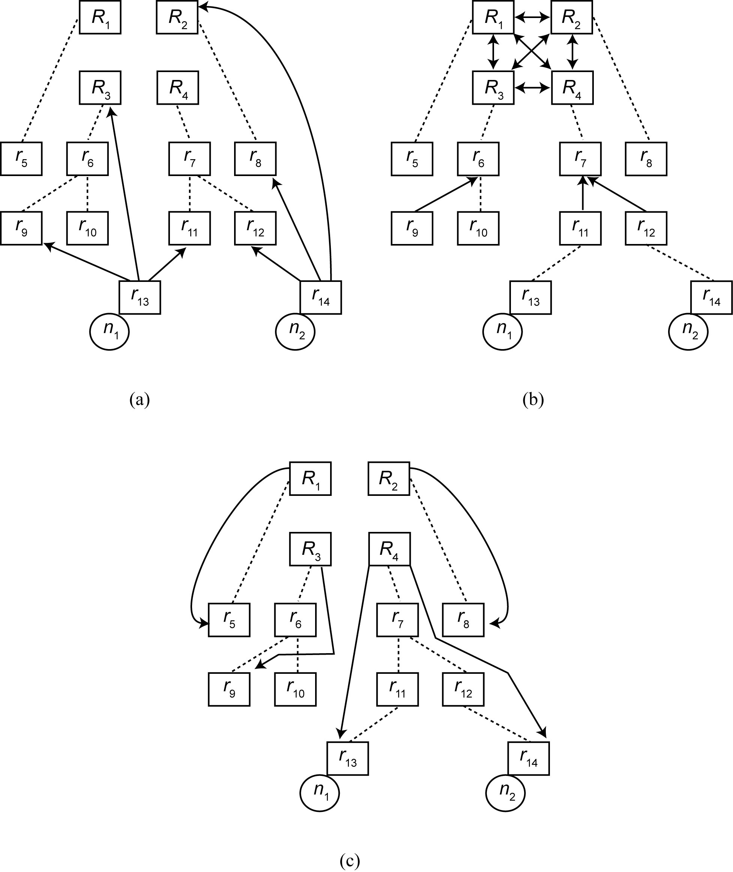
Reconciliation in OceanStore
R_{i} and r_{i} denote, respectively, a primary and a secondary copy of object R
Nodes n₁ and n₂ are concurrently updating R as follows
Nodes that hold primary copies of R, called the master group of R, are responsible for ordering updates
(a) n₁ and n₂ perform tentative updates on their local secondary replicas and send these updates to the master group of R as well as to other random secondary replicas
(b) The tentative updates are ordered by the master group based on timestamps assigned by n₁ and n₂, and epidemically propagated among secondary replicas
(c) Once the master group obtains an agreement, the result of updates is multicast to secondary replicas

Slide 55
Conclusion
Advanced P2P applications will need high-level data management services
Various P2P networks will improve
Network-independence crucial to exploit and combine them
Many technical issues
Decentralized schema management, complex query processing, transaction support and replication, and data privacy
Important to characterize applications that can most benefit from P2P with respect to other distributed architectures

